Slide 1
Judging in a High-Profile Case
Judge Maya Guerra Gamble
459th District Court

Slide 2
Traditional, In-Person Court

Slide 3
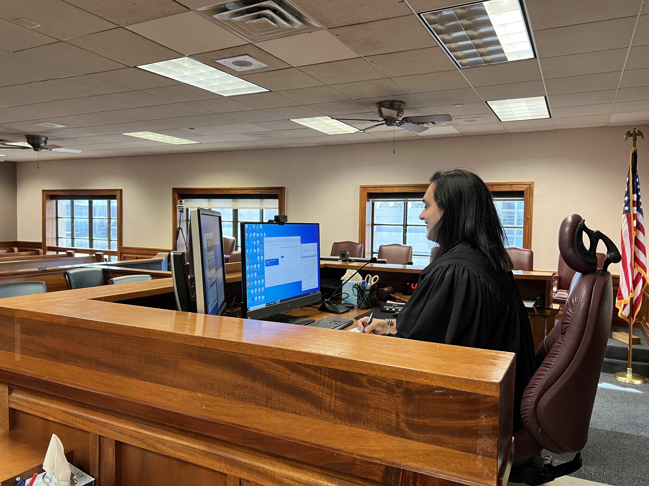
Court: In the Courthouse

Slide 4
6th Amendment to the Constitution
The Sixth Amendment guarantees the rights of criminal defendants, including the right to a public trial without unnecessary delay, the right to a lawyer, the right to an impartial jury, and the right to know who your accusers are and the nature of the charges and evidence against you. It has been most visibly tested in a series of cases involving terrorism, but much more often figures in cases that involve (for example) jury selection or the protection of witnesses, including victims of sex crimes as well as witnesses in need of protection from retaliation.

Slide 5
YouTube

Slide 6
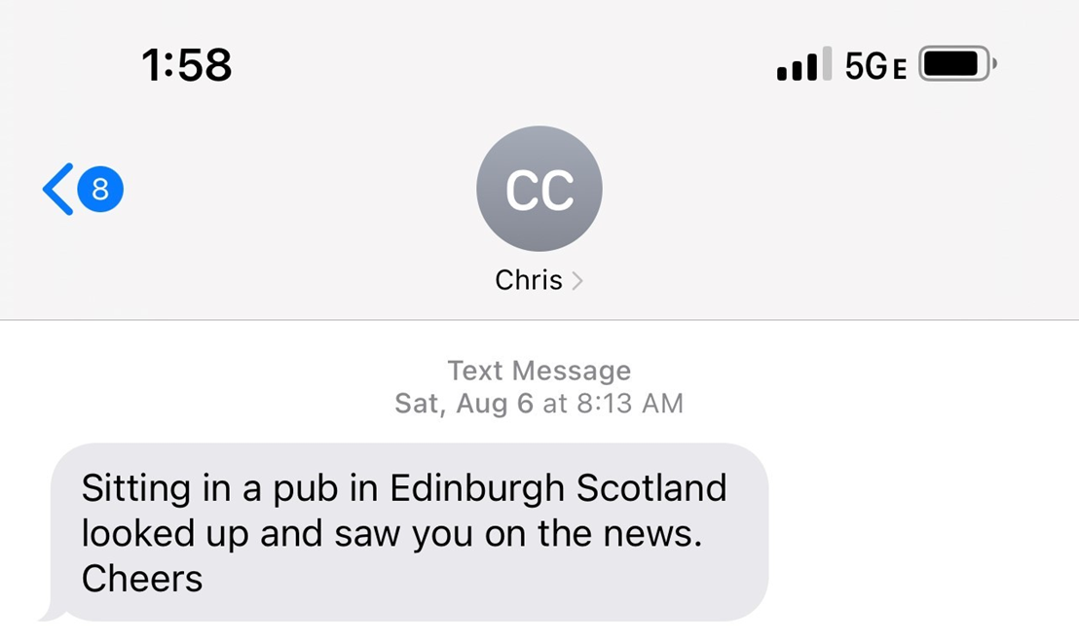

Slide 7
TikTok

Slide 8
Clips Available on YouTube

Slide 9
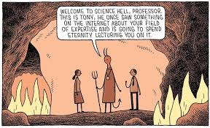
Internet Experts

Slide 10
Juror Oath
“Do each of you solemnly swear or affirm that, in the case
on trial, you will render a true verdict according to the law stated in the charge by the court and to the evidence
submitted to you under the rulings of the court?”

Slide 11
Instruction on Implicit Bias
Do not let bias, prejudice, or sympathy play any part in your evaluation of the evidence admitted or testimony heard in this case. Everyone, including me, has feelings, assumptions, perceptions, fears, and stereotypes that we may not be aware of but that can affect what we see and hear, how we remember what we see and hear, and how we make decisions. Because you are making important decisions as the jurors in this case, you must evaluate the evidence carefully, and you must not jump to conclusions based on personal likes or dislikes, generalizations, gut feelings, prejudices, sympathies, stereotypes, or biases. Techniques to identify and check one’s implicit biases include: slowing down and examining your thought processes thoroughly to identify where you may be relying on reflexive, gut reactions or making assumptions that have no basis in the evidence; asking yourself whether you would view the evidence differently if the players were reversed or other types of people were involved; and listening carefully to the opinions of your fellow jurors, each of whom brings a different, valid perspective to the table. Our system of justice is counting on you to render a just verdict based on the evidence, not on biases.

Slide 12
Instruction on Implicit Bias
“Do not let bias, prejudice, or sympathy play any part in your evaluation
of the evidence admitted or testimony heard in this case.”
Purpose: Instructs against explicit and implicit bias.

Slide 13
Instruction on Implicit Bias
“Everyone, including me, has feelings, assumptions, perceptions, fears, and stereotypes that we may not be aware of but that can affect what we see and hear, how we remember what we see and hear, and how we make decisions.”
Purpose: Empathy regarding and education on what implicit bias is.

Slide 14
Instruction on Implicit Bias
“Because you are making important decisions as the jurors in this case, you must evaluate the evidence carefully, and you must not jump to conclusions based on personal likes or dislikes, generalizations, gut feelings, prejudices, sympathies, stereotypes, or biases.”
Purpose: Informs juror’s as to what is at stake.

Slide 15
Instruction on Implicit Bias
“Techniques to identify and check one’s implicit biases include: slowing down and examining your thought processes thoroughly to identify where you may be relying on reflexive, gut reactions or making assumptions that have no basis in the evidence; asking yourself whether you would view the evidence differently if the players were reversed or other types of people were involved; and listening carefully to the opinions of your fellow jurors, each of whom brings a different, valid perspective to the table.”
Purpose: Offers jurors specific methods they can use to try to reduce the effect of their biases on their thinking and decision-making. (Source: Connecticut Implicit Bias Jury Instruction).

Slide 16
Instruction on Implicit Bias
“Our system of justice is counting on you to render a just verdict based on the evidence, not on biases.”
Purpose: Calls jurors to a higher place and motivates them to guard against bias infecting process.

Slide 17
Juror Questions

Slide 18
I can laugh at this (transcript of a call I received).
“Well, I got some bad news for you lady. all the pain that you're creating an Alex Jones life is going to come back to you seven times. I curse. You people everyday. I pray to God that he strikes down you. People like you your families friends loved ones and Associates for the evil. You're doing against him say that he's innocent. What kind of kangaroo I tell you what this country is going down there. All the evil ones are going to be struck down first before it's completely destroyed cuz we know you're being paid by George Soros and you work for the world economic forum and who and all this evil organizations. That that's destroying the greatest nation that ever existed and all you responsible for that is going to burn forever burn. Call me. Have a nice day.”

Slide 19
But I can’t laugh at this (phone message).
“Hey Maya, it's your buddy. George Soros. You know the Nazi conspirator. I just want to thank you for wiping your ass with the Constitution. and the Bill of Rights in the whole due process that exists in the United States of America because that is the goal to get rid of it. Oh, yeah and to capture all the kids from CPS right. You're a real f****** American hero, aren't you? Peace of garbage? You wouldn't know the Constitution if it shoved itself up your ass.”

Slide 20
And I really can’t laugh at these.

